Slide 1
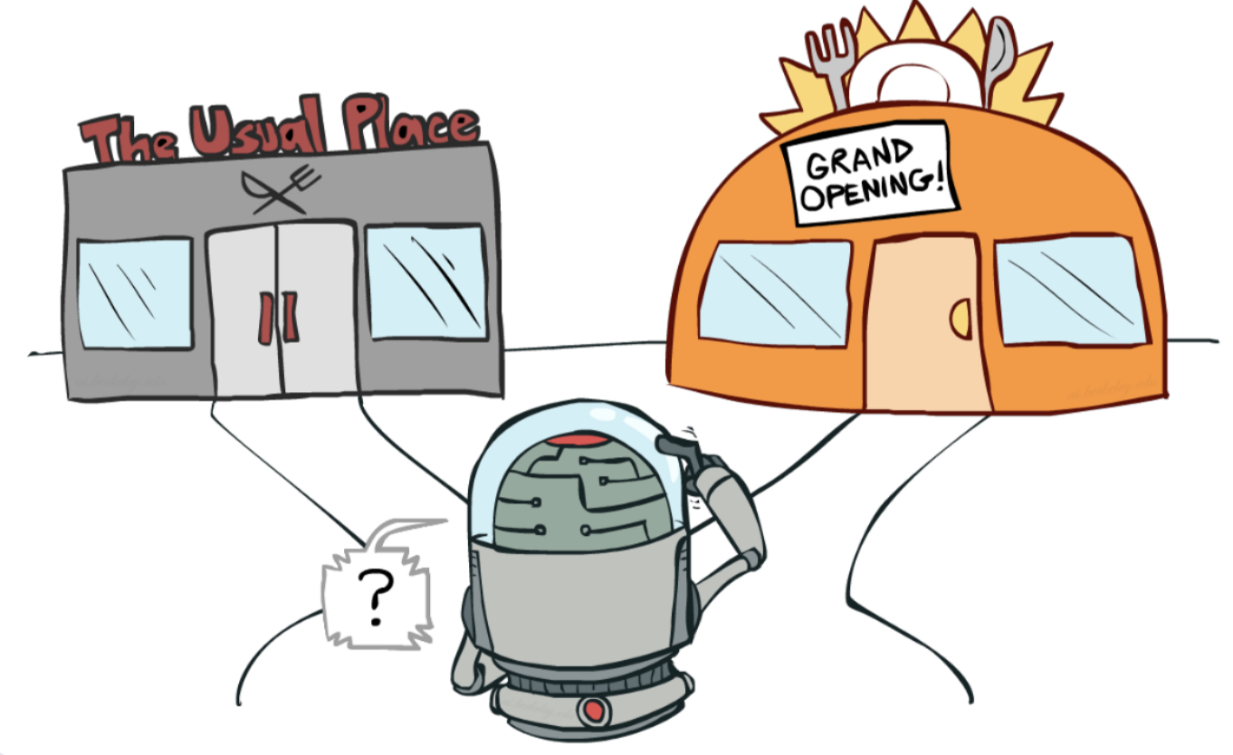
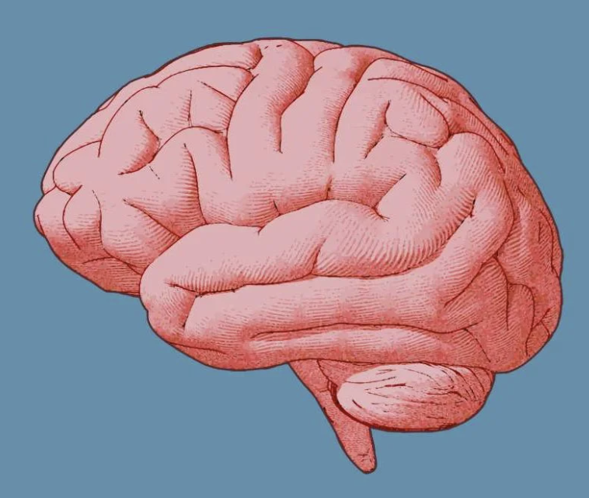
Exploration/Exploitation
Quilee Simeon, Sol Markman, Jack Gabel, and Hokyung Sung

Slide 2

What is the exploration/exploitation trade-off?

Slide 3
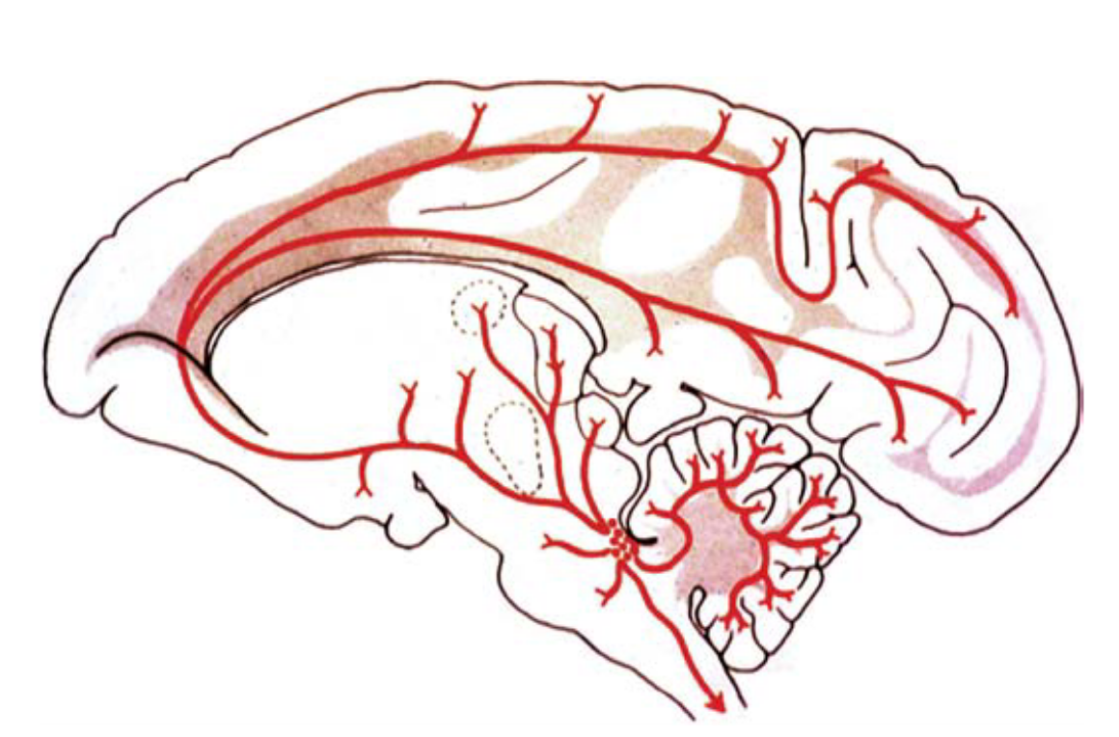
Locus Coeruleus–Norepinephrine System
Regulates exploration versus exploitation
Adaptive gain theory
LC influences cortex via NE
Two LC modes: Phasic and Tonic
Phasic: Selective increase in responsivity to task stimuli
Exploit current task
Tonic: Broad increase in responsivity
Exploration
Notes:
Phasic LC -> Phasic NE release -> Increased responsivity -> Potentiated processing of stimuli

Slide 4
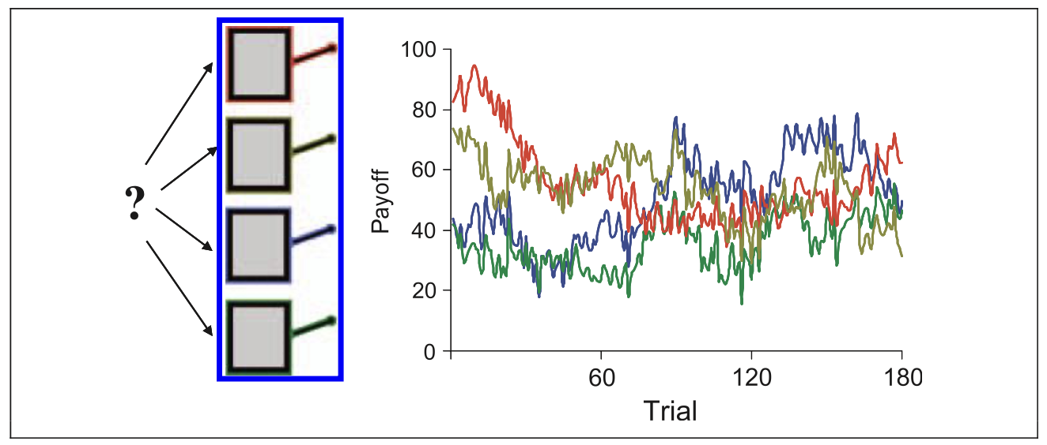
Bandit task for assessing explore-exploit tradeoff
Jepma, Marieke, and Sander Nieuwenhuis. "Pupil diameter predicts changes in the exploration–exploitation trade-off: Evidence for the adaptive gain theory." Journal of cognitive neuroscience 23.7 (2011): 1587-1596.
Notes:
Figure 1. The four-armed bandit task. Participants made repeated choices between four slot machines. Unlike standard slots, the mean payoffs of
the four machines changed gradually and independently from trial to trial (four colored lines). Participants were encouraged to earn as many points as possible during
the experiment. After the experiment, each choice was classified as exploitative or exploratory using a computational model of reinforcement learning.
In our simulation we kept the mean payoffs of each slot machine fixed over time.

Slide 5


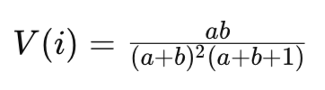
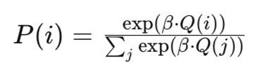
Tracking Uncertainty with a Bayesian Model
Notes:
M # expected reward probability (mean of beta distribution)
V # reward uncertainty (variance of beta distribution)
Q # decision value
P # choice probabilities
MAIN Results of Jepma and Nieuwenhuis (2011)
We examined the relationship between pupil diameter, task utility, and choice strategy (exploitation vs. exploration), and found that (i) exploratory choices were preceded by a larger baseline pupil diameter than exploitative choices; (ii) individual differences in baseline pupil diameter were predictive of an individualʼs tendency to explore; and (iii) changes in pupil diameter surrounding the transition between exploitative and exploratory choices correlated with changes in task utility.

Slide 6
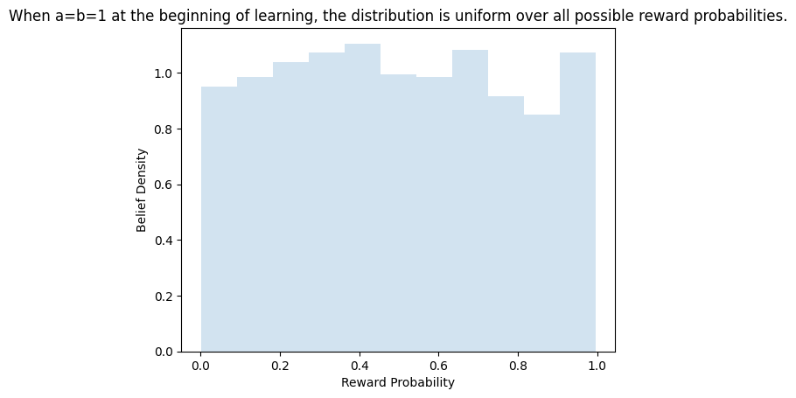
Tracking Uncertainty with a Bayesian Model
Agent has a belief distribution for each choice/option (e.g. slot machine)
Jepma, Marieke, and Sander Nieuwenhuis. "Pupil diameter predicts changes in the exploration–exploitation trade-off: Evidence for the adaptive gain theory." Journal of cognitive neuroscience 23.7 (2011): 1587-1596.
Notes:
Each option (e.g. slot machine) is associate with its own beta distribution, which represents the agent’s belief of the reward probabilities of that choice.

Slide 7
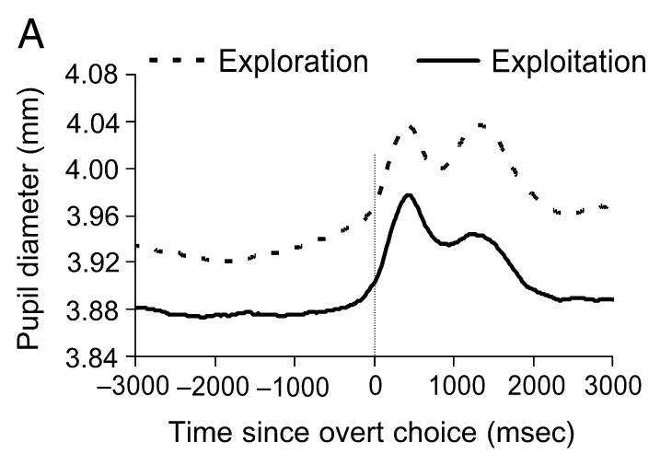
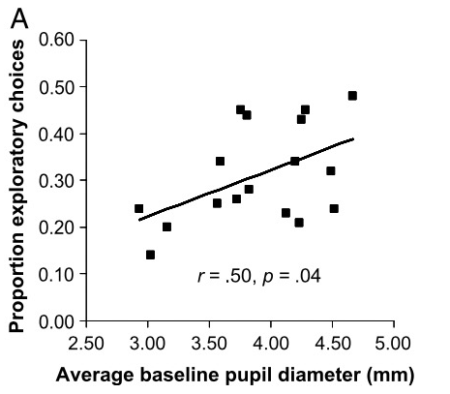
Pupil diameter in exploration/exploitation
Figure 2
Figure 4
Jepma and Nieuwenhuis (2011)
Notes:
Q1: Show how this model can account for the relationship between pupil diameter and exploration/exploitation under the assumption that baseline pupil diameter is proportional to the entropy of the distribution over actions.
LEFT Figure 2A of Jepma & Nieuwenhuis (2011)
Pupil diameter on exploration and exploitation trials. (A) Time course of grand-average pupil diameter aligned to the keypress indicating the selection of a slot machine for exploratory and exploitative choices.
RIGHT Figure 4A of Jepma & Nieuwenhuis (2011)
Individual differences in pupil diameter and exploratory choice behavior. (A) Scatterplot of the between-subjects correlation between average baseline pupil diameter and the proportion of exploratory choices.
In our simulations, we did not track reaction time of our agent over the time course of single trials. Each trial can be thought of as an instantaneous stimulus presentation and agent choice, followed by update of model parameters.

Slide 8
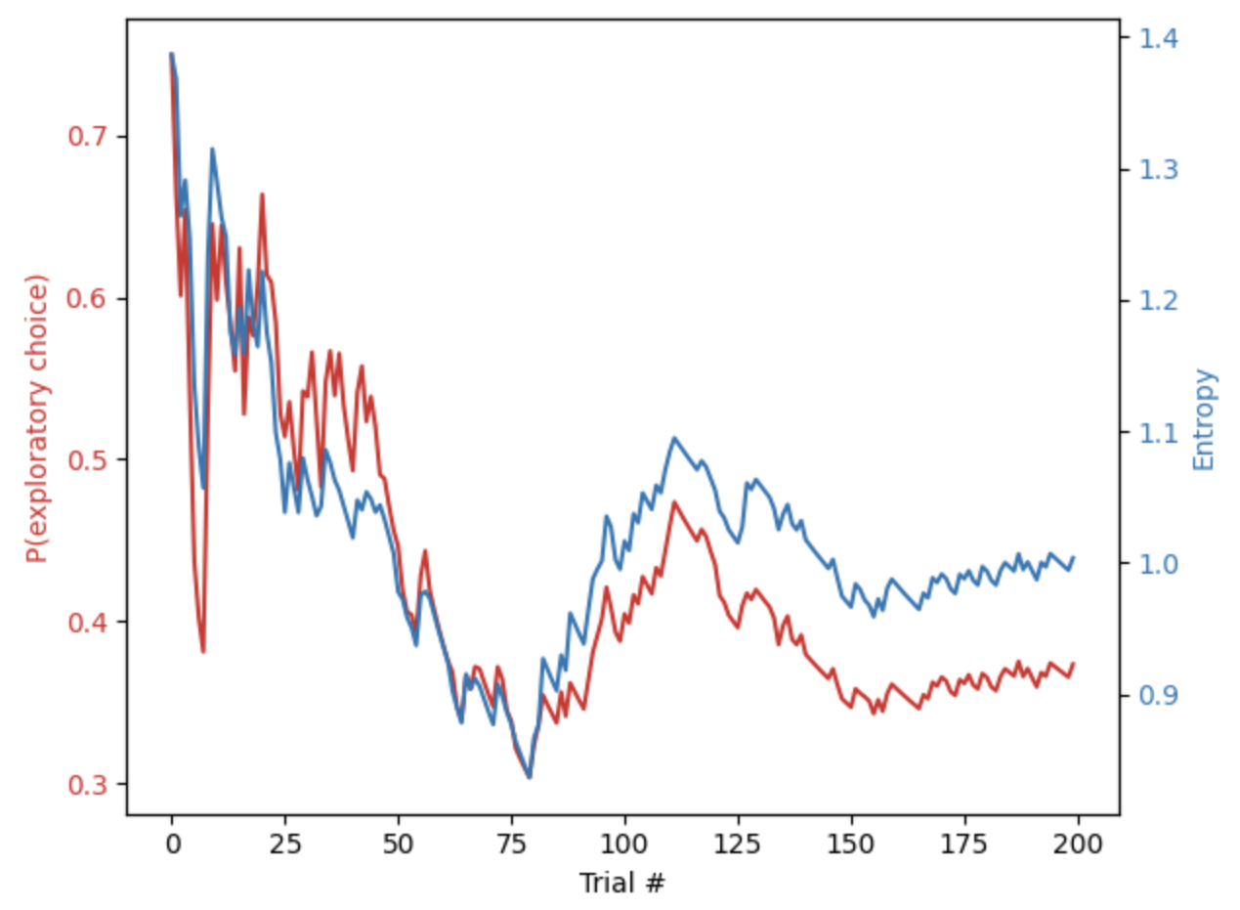
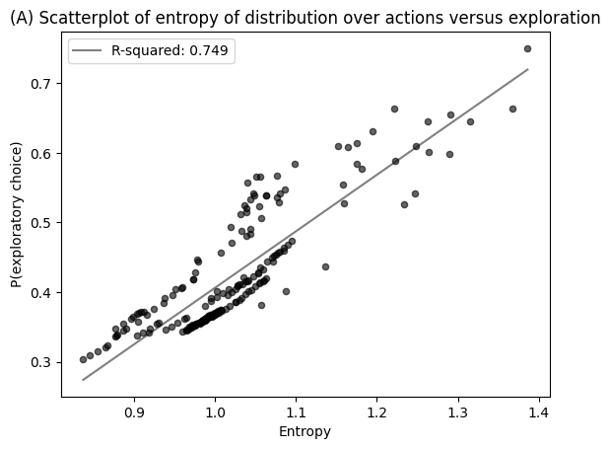
Simulation result
Pupil diameter ~ entropy over action policy
Notes:
Define an exploratory choice as when the model makes a choice that is not the option corresponding to the highest mean (M) value.
We assume entropy and pupil diameter are correlated.
Distribution over actions = Policy
Actions = which option is chosen e.g. which slot machine is played

Slide 9
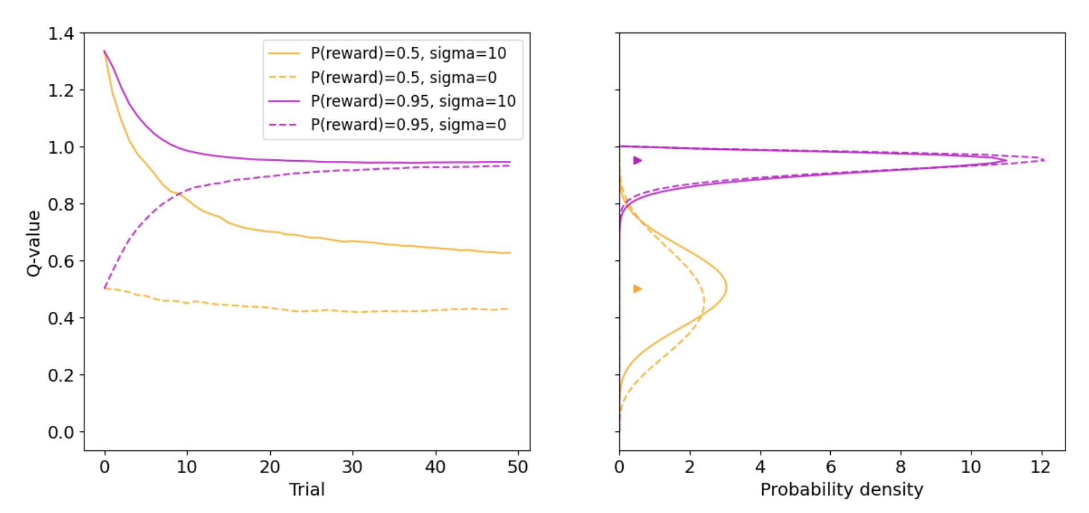
What if we remove the uncertainty bonus?
beta=5
Notes:
Simulation: two-armed bandit, one choice is rewarding with high certainty (P=0.95), the other is uncertain (P=0.5).
With a very high uncertainty bonus (sigma=10), the uncertain option (P=0.5) remains more “intrinsically valuable” than it would be with no uncertainty bonus.
Meanwhile, since the variance of the beta distribution (V) for the certainly rewarding option (P=0.95) quickly becomes very low, it does not benefit much from the uncertainty bonus.

Slide 10
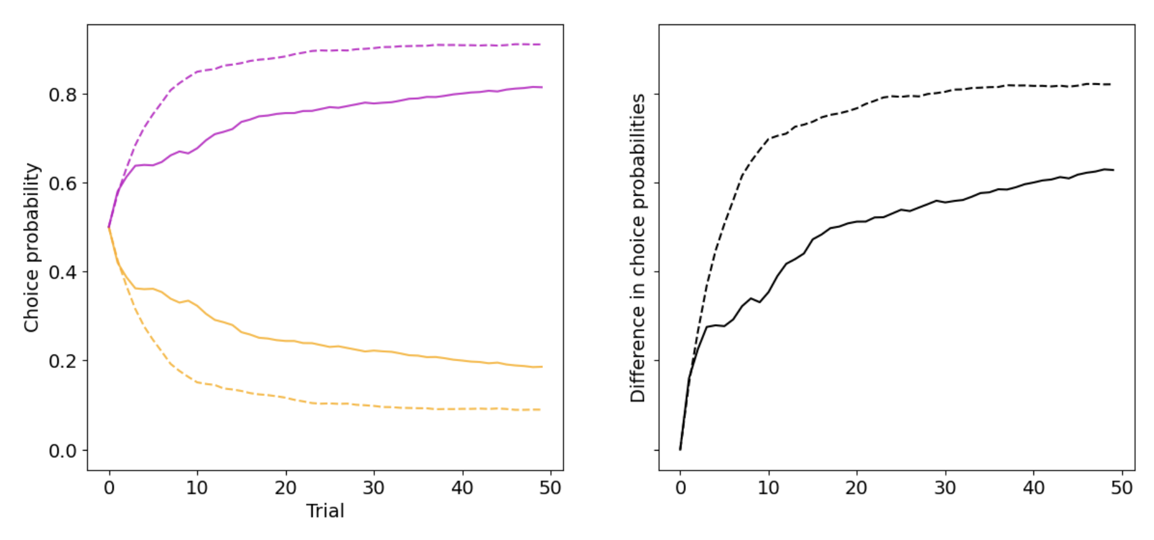
What if we remove the uncertainty bonus?
beta=5
Notes:
Choice probability: effect on the actual choice behavior. The difference between high vs no uncertainty bonus becomes clear when looking at the difference between choice probabilities.
Transition into how to test if people use the uncertainty bonus.

Slide 11
How could we test if people use an uncertainty bonus?
Option A
Option B
50% probability of reward
50% probability of reward
Assume the subject has been shown 20 trials of A and 100 trials of B, and is then presented with a choice. Which one will they choose?

Slide 12
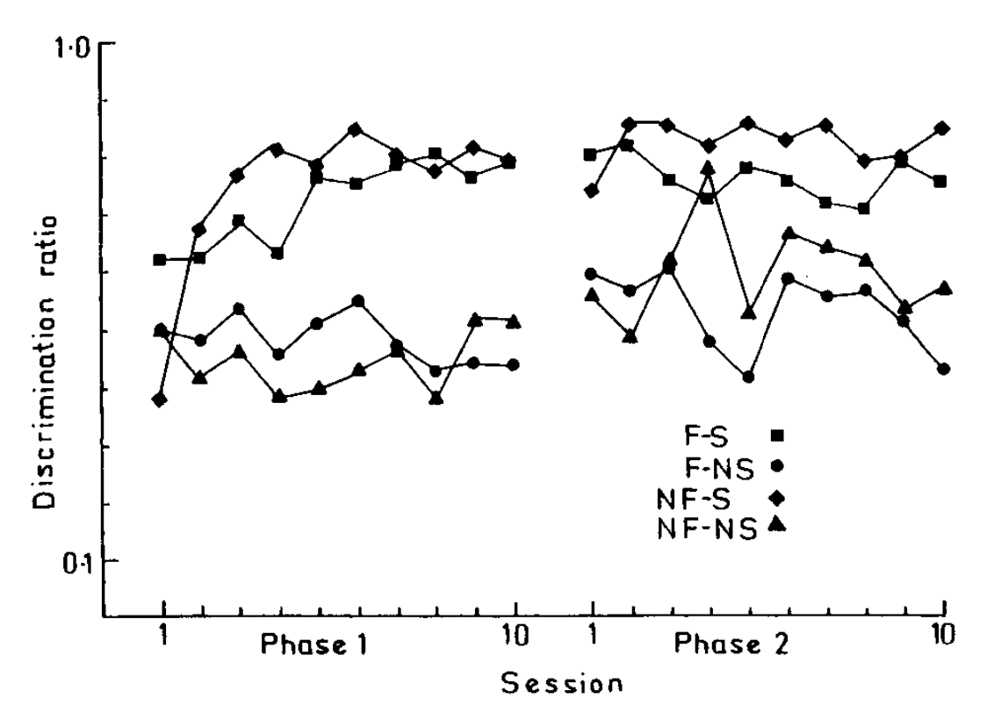
Connection to novelty bonuses
Animals have been shown to treat novelty as rewarding
Reed, Phil, Chris Mitchell, and Tristan Nokes. "Intrinsic reinforcing properties of putatively neutral stimuli in an instrumental two-lever discrimination task." Animal Learning & Behavior 24.1 (1996): 38-45.
Session
Notes:
Mean discrimination ratios for all groups in Experi- ment 3. F-NS =food deliveries, no stimulus presentations. F-S = food deliveries, stimulus presentations on target lever. NF-NS = no food and no stimulus presentations. NF-S = no food presenta- tions, stimulus presentations on target lever. Phase 2 = same con- tingencies except food never presented within 5 sec of a response.

Slide 13
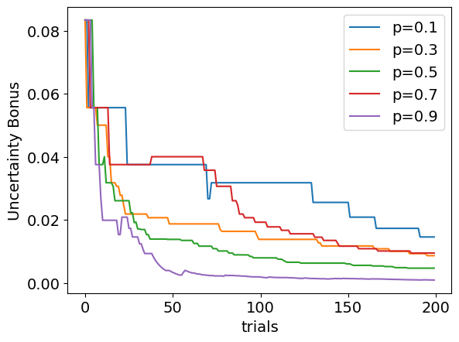
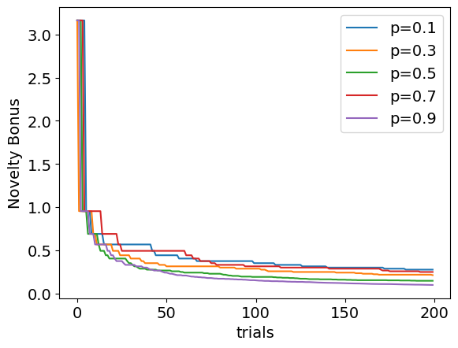
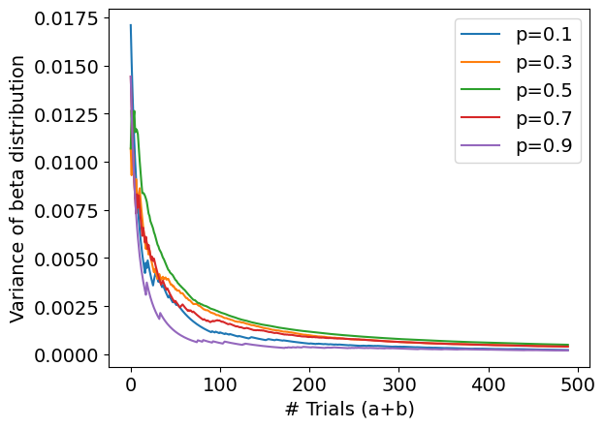
Novelty vs. Uncertainty?
Novelty bonuses can encourage exploration similar to an uncertainty bonus
Notes:
Mean discrimination ratios for all groups in Experi- ment 3. F-NS =food deliveries, no stimulus presentations. F-S = food deliveries, stimulus presentations on target lever. NF-NS = no food and no stimulus presentations. NF-S = no food presenta- tions, stimulus presentations on target lever. Phase 2 = same con- tingencies except food never presented within 5 sec of a response.

Slide 14
Discussion Questions
What factors besides utility, uncertainty, and novelty may influence the exploration/exploitation trade-off?
What happens if we do away with the assumption that the reward probabilities of the environment remain stationary? Would we need a reset mechanism for our uncertainty/novelty estimates? How would this be implemented?
Are there situations where a novelty bonus and an uncertainty bonus are different?
Notes:
Social signals

Slide 15
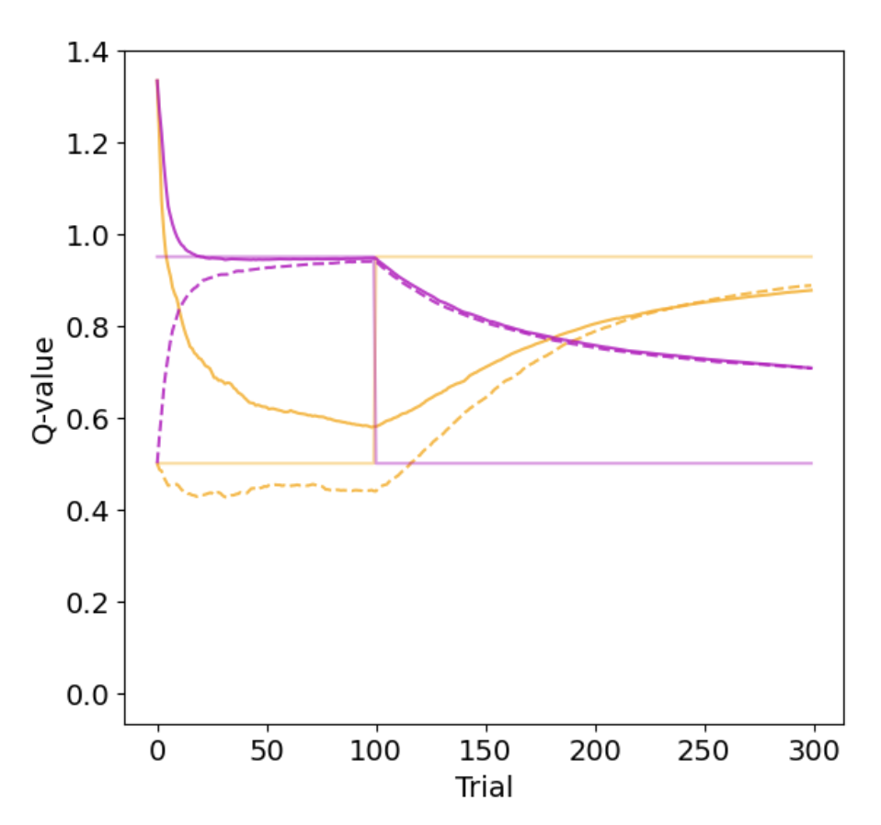
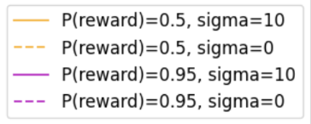
Why a reset mechanism is needed for non-stationary environments
The uncertainty bonus in this model does not help adapt to changes in the environment because the variance of the beta distribution is already low (due to a large number of trials sampled)
→ need to build in a “context switch” where beta distribution parameters reset

